Slide 1
The current state of PowerShell remoting
Christian Lehrer

Slide 3


About_me Name: Christian Lehrer twitter: @chri_tea works at:

Slide 4
The current state of PowerShell remoting
A tail of a man who tried to get PowerShell remoting running (cross-platform)
A beginning of a tail as it should be
The technical story within the tail (Or: the 2 1/2 possible transport layers usable for PowerShell remoting and how they differ)
Peak tragedy (Or: Christian vs. PSRP)
Not all hope is lost (Or: Christian + openSSH)
And he PSremoted even after (Or: some tipps on how to get you PS remoting a little contained)

Slide 5


Slide 6
PowerShell remoting transport protocols
WindowsRemoteManagement / WebServices for Management / PowerShellRemotingProtocol
The Web Services for Management (WS-Management) Specification describes a Web services 291 protocol based on SOAP for use in management-specific domains. These domains include […]PCs, servers, devices, Web services and other applications, and other 293 manageable entities. (from the standards description).
WinRM implements the WSMan protocol for use in Windows.
PSRP enhances the limitations of pure WinRM (especially possible packet size) and makes full PowerShell remoting available.
Benefits:
in the box since Windows Vista
easy configuration
secure transport and authentication (when unchanged)
JEACustom configurations
Drawbacks:
only fully functional on Windows
by default only administrators can connect via PS-remoting (can be changed)

Slide 7
PowerShell remoting transport protocols
SecureSHell / PowerShellRemotingProtocol
SSH is a cryptographic network protocol for operating network services securely over an unsecured network. Typical applications include remote command line, login, and remote command execution, but any network service can be secured with SSH. (Wikipedia)
Benefits:
Well known (since Windows 10 1709/Server 2016 also natively in Windows through OpenSSH)
secure authentication
even non-admins can use PS-remoting (without admin-permission)
Drawbacks:
No JEA
no custom configurations
no support on older Windows versions

Slide 8
Wsman in a multi-OS world
Setting up on Windows with Windows PowerShell
Windows Vista and above
Installation:
No installation needed.
Configuration
Check the running state of the WinRM service
WinRm quickconfig (sets-up default configuration for the WSMan listener)
Allow traffic (port 5985, 5986)through the firewall
Since Windows Server2012 WSMan is set up with the default configuration out of the box. This allows PS remoting access from private or domain networks for members of the administrators group.
DEMO

Slide 9

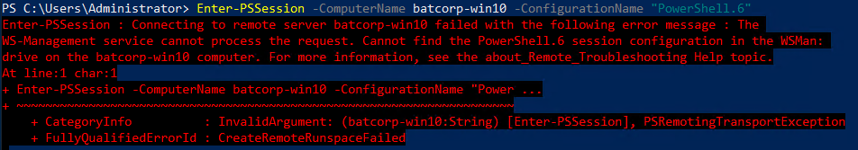
Wsman in a multi-OS world
Setting up on Windows with PowerShell Core for Windows
Installation:
No installation needed.
Configuration
Depending on PSCore version, running the script install-PowerShellremoting.ps1 in $home might be needed:
Creates a directory for the plug-in within $env:windir\System32\PowerShell
Copies pwrshplugin.dll to that location
Generates a configuration file
Registers that plug-in with WinRM
WinRm must be running
Allow traffic (port 5985, 5986)through the firewall
DEMO PS5.1 to PSCore6.2

Slide 10



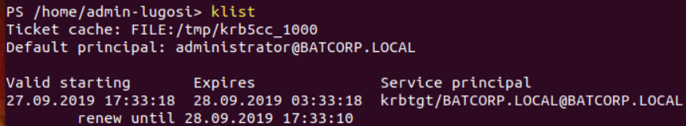
Wsman in a multi-OS world
Setting up on Linux with PowerShell Core
Installation:
PSRP communication is tunneled through the Open Management Infrastructure (OMI) using this OMI provider.
Status from a year ago:Two parts of PSRP are available - server and client. The client PSRP part (libpsrpclient) is under development, and will be distributed together with PowerShell. The server PSRP package is available now and should be installed after installing OMI as it is an OMI provider.
Newererer theory: install OMI on Ubuntu 18.04, install PSRP from the repo, set trustedhosts on Windows Endpoint, configure SPNEGO for NTLM authentication -> live long an prosper
Real World: Get SPNEGO running by installing SAMBA on Linux, changing existing configs -> How about no? Remember, this should be usable in a productive environment.
Alternative: create a file where you store your credentials in clear text and SPNEGO can access it in your name: Eeeehm, no!
Newererer theory: blabla, use Kerberos -> live long an prosper
Real World: installing krb5, configuring krb5_conf, getting Ticket!
Newerererer theory: forgert PSRP on PSCore (non-Windows) for now. Even the team did:
“PowerShell remoting uses OMI only as a bridge for non-Windows platforms. Its support of WinRM client is incomplete and problematic. My goal is to completely remove OMI as a dependency. I agree with @SteveL-MSFT that the best way to do this is to investigate implementing WinRM client in cross-platform managed code, resulting in an RFC that outlines the work required.“
https://github.com/PowerShell/PowerShell/issues/8233
Newererer theory: blabla, use Kerberos -> live long an prosper
Real World: installing krb5, configuring krb5_conf, getting Ticket -> doesn´t matter, still no PSSession ☹
Theory: install OMI on Ubuntu 19.04, install PSRP, set trustedhosts on Windows Endpoint -> live long an prosper
Real World: Install OMI: Problem: not supported on current ubuntu version, last one is 18.04 - > switch to 18.04 -> repeat theory
New theory: install OMI on Ubuntu 18.04, install PSRP, set trustedhosts on Windows Endpoint -> live long an prosper
Real World: Install Ubuntu, Install OMI: Problem: PSRP from Microsoft repository is not supported on Ubuntu 18.04! Last supported version: 16.10
Newer theory: install OMI on Ubuntu 18.04, install PSRP from the repo, set trustedhosts on Windows Endpoint, connect via basic auth as is advised in the documentation -> live long an prosper
Real World: Basic Authentication is not supported in *nix systems for Psremoting (since an RFC in 2018)
Newerer theory: install OMI on Ubuntu 18.04, install PSRP from the repo, set trustedhosts on Windows Endpoint, create custom certificate on Windows host, connect via ssl and basic auth -> live long an prosper
Real World:

Slide 11
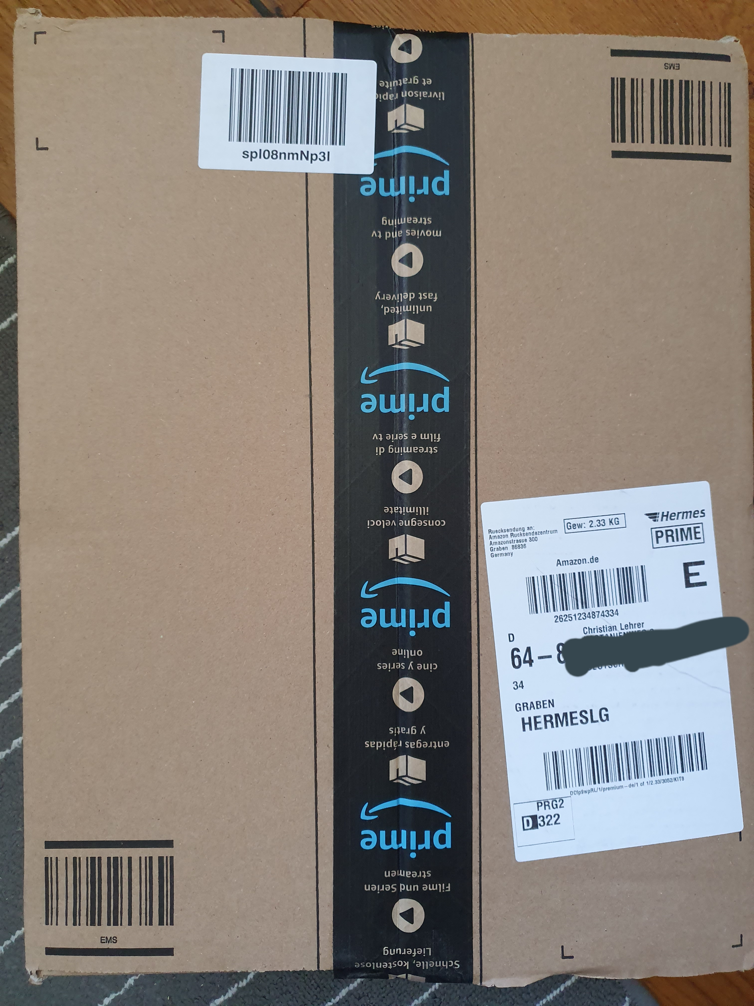
Wsman in a multi-OS world
Setting up on MacOS with PowerShell Core
Shit, no macbook. -> Presentation done…

Slide 12
Wsman in a multi-OS world
Setting up on MacOS with PowerShell Core
Installation:
OpenSSL -> was already on box
Basic auth -> not supported by PowerShell Core
SPNEGO -> not supported by Apple
Christian: ¯\_(ツ)_/¯

Slide 13
Trying it with OpenSSH
Setting up OpenSSH on Windows 10 1709 or Server 2016 and above
Get-WindowsCapability -Online | where {$_.name -like "openssh.server*"} | Add-WindowsCapability –Online
Get-WindowsCapability -Online | where {$_.name -like "openssh.client*"} | Add-WindowsCapability –Online
(get-service *ssh* | Set-Service -StartupType manual) (or automatic for constant use)
Start services (get-service *ssh* | Start-Service)

Slide 14
Trying it with OpenSSH
Setting up OpenSSH on Windows 10 1709 or Server 2016 and above
Change sshd_config ($env:ProgramData\ssh) to allow password authentication and add in the PWSH subsystem:
PasswordAuthentication yes
Subsystem powershell c:/program files/powershell/6/pwsh.exe -sshs -NoLogo –NoProfile
Corrected: Subsystem powershell c:/pwsh/pwsh.exe -sshs -NoLogo –NoProfile
(after creating symbolic link with new-item -ItemType SymbolicLink -path c:\ -name "pwsh" -Value "C:\Program Files\PowerShell\6\„ )
Restart services
Check if openSSH installation created the correct firewall rule (Port22 TCP)
DEMO

Slide 15
Trying with openSSH
Setting SSH for PS remoting on Ubuntu 18.04
Installation:
Install openSSH server and client if not already on the box (sudo apt install openssh-server/client)
Configure sshd.config
PasswordAuthentication yes
Subsystem powershell %yourpathtopwsh% -sshs –noLogo –noProfile
Restart service

Slide 16
Trying with openSSH
Setting SSH for PS remoting on MacOS
Installation:
openSSH should be on the box already, if not check brew to install it
Enable remote management (System preferences, sharing, remote login on, select users to access)
Configure sshd.config (private/etc/ssh/sshd_config)
PasswordAuthentication yes
Subsystem powershell /usr/local/bin/pwsh -sshs –noLogo –noProfile
Restart service (sudo launchctl stop com.openssh.sshd, sudo launchctl start com.openssh.sshd)
DEMO (W10->MacOS)
DEMO (U1804->MacOS)
DEMO (MacOS->Linux)

Slide 17
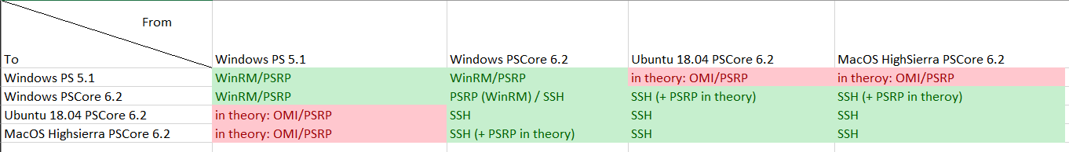
Overview
Comment from Richard Siddaway: In non-domain joined Windows scenarios, go for SSH also!

Slide 18
Making use of the openSSH possibilities
Private / Public key authentication
On windows host:
Configure sshd_conf
comment out #AuthorizedKeysFile __PROGRAMDATA__/ssh/administrators_authorized_keys
Restart sshd service
Install module “OpenSSHUtils”

Slide 19
Making use of the openSSH possibilities
Private / Public key authentication
On MacOS/Linux Client:
Create a public / private key pair
Upload the public part to the .ssh folder of the windows users you want to be logged in as
Repair permissions with „repair-authorizedkeys“ from openSSHUtils module (be careful!)
DEMO
DEMO

Slide 20
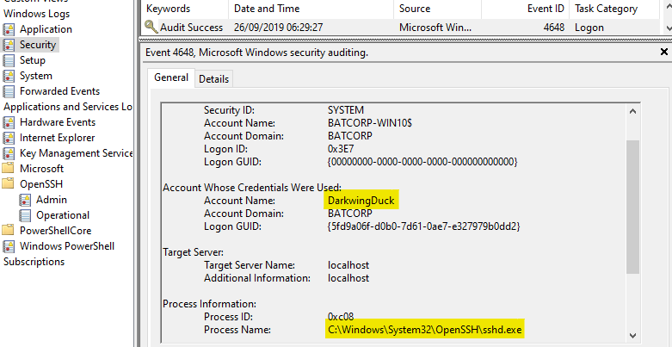
Detecting SSH logins on Windows

Slide 21
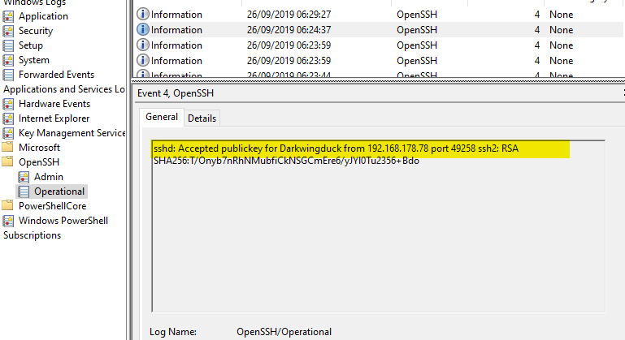
Detecting SSH logins on Windows

Slide 22
Contain the use of PS Remoting
JEA
WSMan configuration (Filters) -> Possible, but don´t
Firewall-rules
sshd config

